Slide 1
Lexicon Enhanced Chinese Sequence Labelling Using BERT Adapter
Wei Liu , Xiyan Fu , Yue Zhang , Wenming Xiao
DAMO Academy, Alibaba Group, China
College of Computer Science, Nankai University, China
School of Engineering, Westlake University, China
Institute of Advanced Technology, Westlake Institute for Advanced Study

Slide 2
Introduction
Chinese sequence labeling is more challenging due to the lack of explicit word boundaries in Chinese sentences.
There are two lines of recent work enhancing character-based neural Chinese sequence labeling
The first considers integrating word information into a character-based sequence encoder, so that word features can be explicitly modeled
The second considers the integration of large-scale pre-trained contextualized embeddings, such as BERT

Slide 3
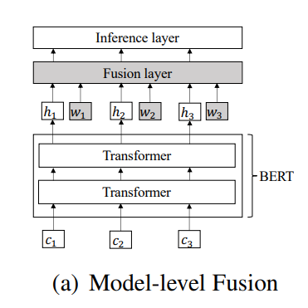
Introduction
Recent work considers the combination of lexicon features and BERT
The main idea is to integrate contextual representations from BERT and lexicon features into a neural sequence labeling model

Slide 4
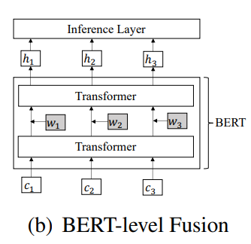
Introduction
Inspired by the work about BERT Adapter, we propose Lexicon Enhanced BERT (LEBERT) to integrate lexicon information between Transformer layers of BERT directly.
A lexicon adapter is designed to dynamically extract the most relevant matched words for each character using a char-to-word bilinear attention mechanism

Slide 5
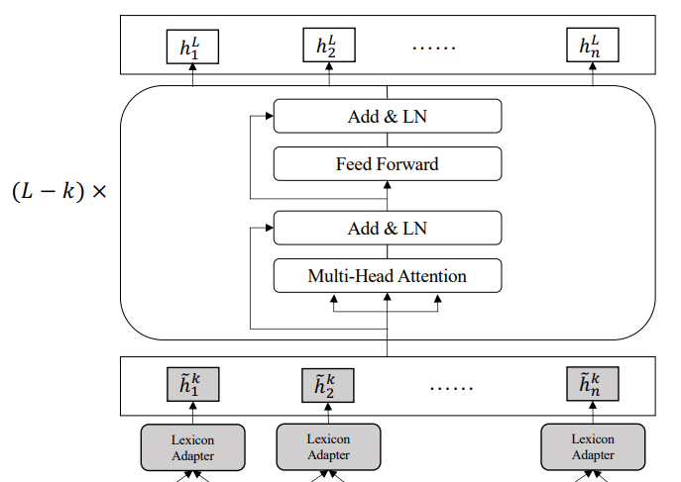
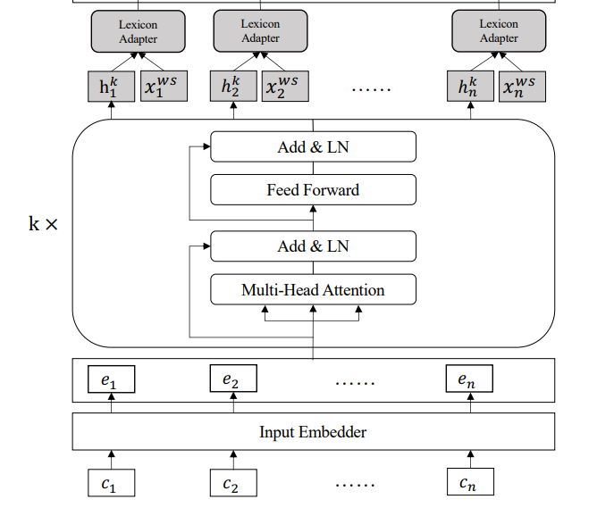
Method

Slide 6
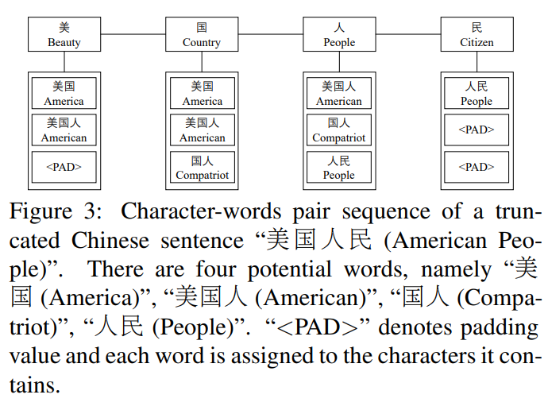

Method
Char-Words Pair Sequence
Given a Chinese Lexicon D and a Chinese sentence with n characters $s_{c}$ = {$c_{1}$, $c_{2}$, ..., $c_{n}$}

Slide 7
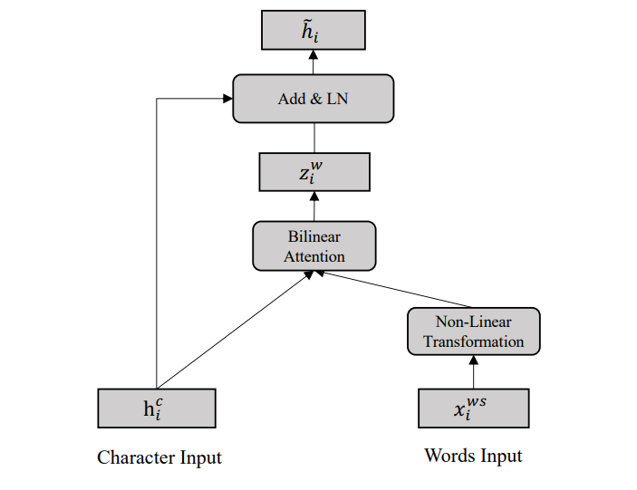
Method
Lexicon Adapter
Each position in the sentence consists of two types of information, namely character-level and word-level features.

Slide 8


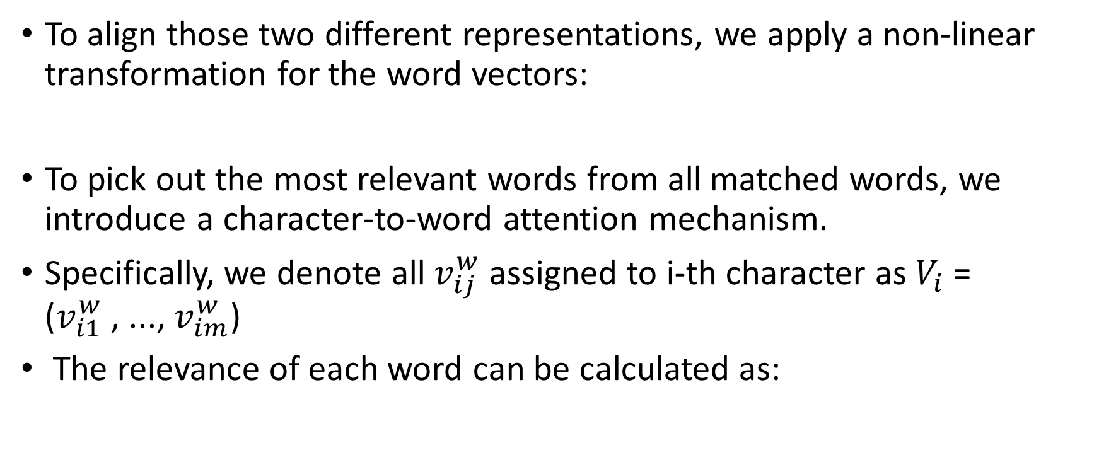
Method
To align those two different representations, we apply a non-linear transformation for the word vectors:
To pick out the most relevant words from all matched words, we introduce a character-to-word attention mechanism.
Specifically, we denote all $v_{ij}^{w}$ assigned to i-th character as $V_{i}$ = ($v_{i1}^{w}$ , ..., $v_{im}^{w}$)
The relevance of each word can be calculated as:

Slide 9
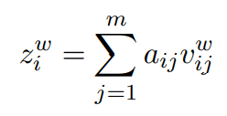

Method
we can get the weighted sum of all words by:
Finally, the weighted lexicon information is injected into the character vector by:

Slide 10

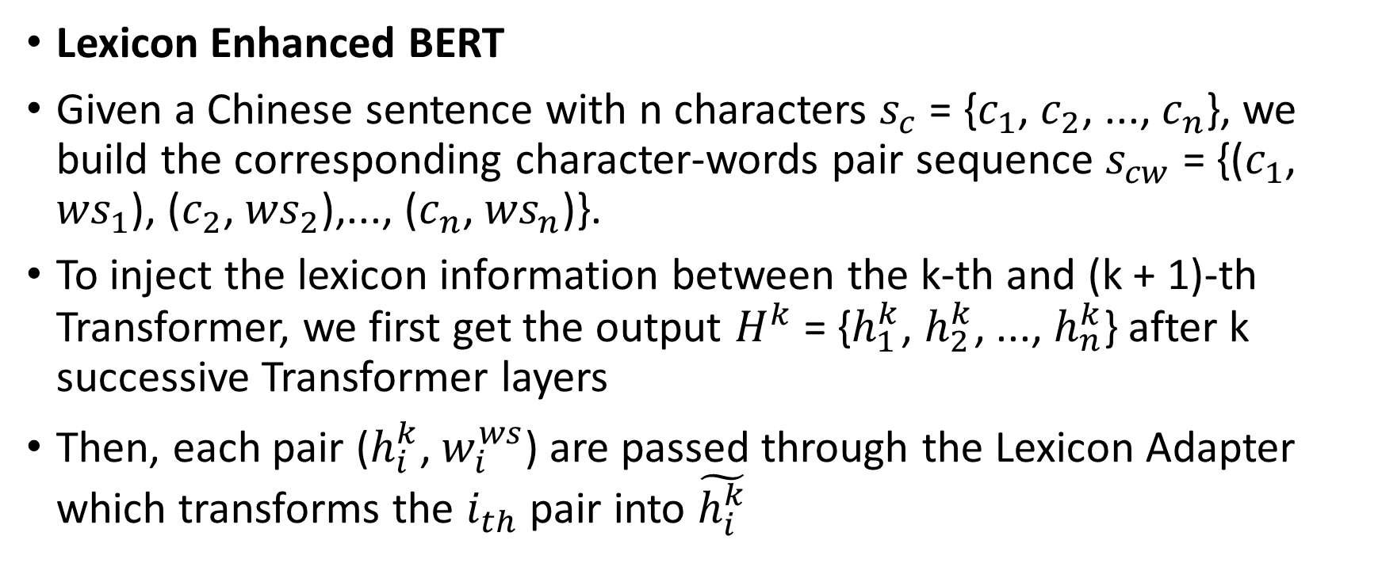
Method
Lexicon Enhanced BERT
Given a Chinese sentence with n characters $s_{c}$ = {$c_{1}$, $c_{2}$, ..., $c_{n}$}, we build the corresponding character-words pair sequence $s_{cw}$ = {($c_{1}$, ${ws}_{1}$), ($c_{2}$, ${ws}_{2}$),..., ($c_{n}$, ${ws}_{n}$)}.
To inject the lexicon information between the k-th and (k + 1)-th Transformer, we first get the output $H^{k}$ = {$h_{1}^{k}$, $h_{2}^{k}$, ..., $h_{n}^{k}$} after k successive Transformer layers
Then, each pair ($h_{i}^{k}$, $w_{i}^{ws}$) are passed through the Lexicon Adapter which transforms the $i_{th}$ pair into $\tilde{h_{i}^{k}}$

Slide 11
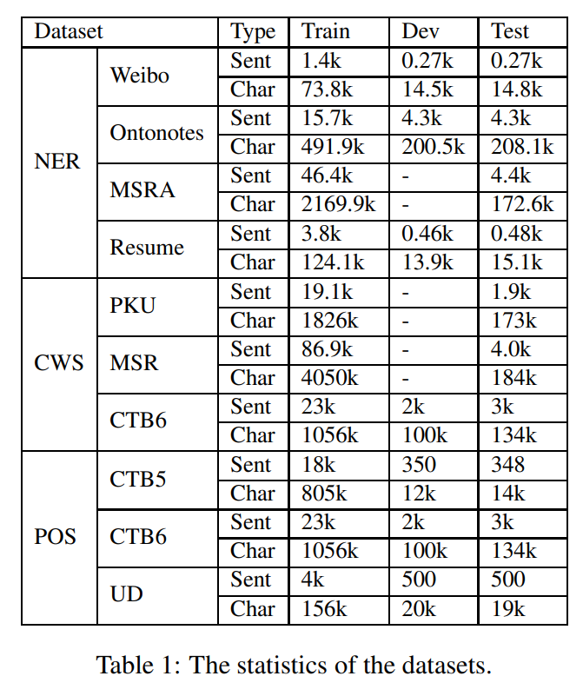
Experiments
Datasets
We evaluate our method on ten datasets of three different sequence labeling tasks, including Chinese NER, Chinese Word Segmentation, and Chinese POS tagging.

Slide 12
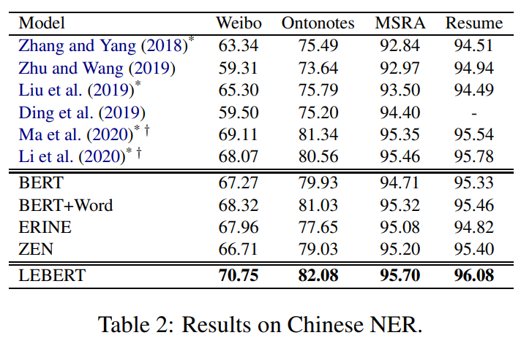
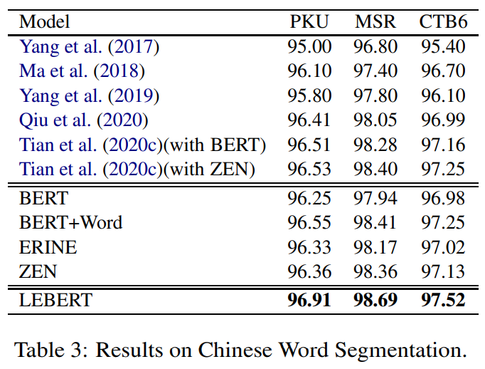
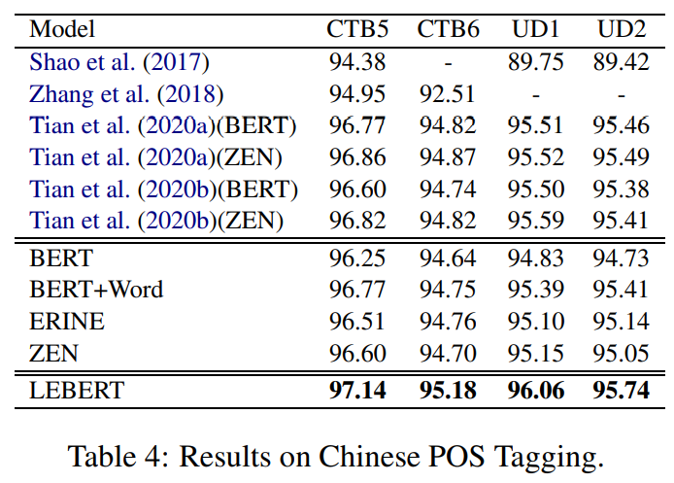
Experiments

Slide 13
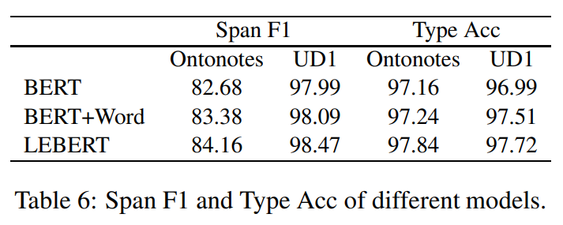
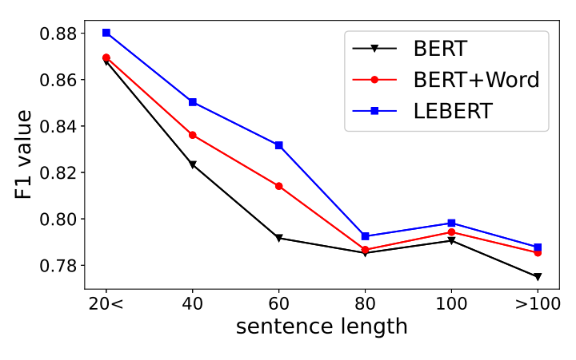
Experiments
Model-level Fusion vs. BERT-level Fusion

Slide 14
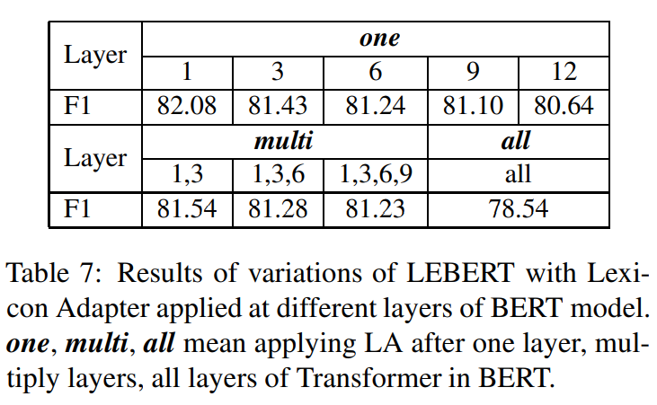
Discussion
Adaptation at Different Layers

