Slide 1
Attention Is All You Need Ashish Vaswani, Noam Shazeer, Niki Parmar, Jakob Uszkoreit, Llion Jones, Aidan N. Gomez, Łukasz Kaiser, Illia Polosukhin
Speaker : Yu-Chen Kuan

Slide 2
OUTLINE
Introduction
Background
Model Architecture
Why Self-Attention
Training
Results
Conclusion
Appendix

Slide 3
Introduction

Slide 4
Introduction
RNN, LSTM, GRU have been firmly established as state of the art approaches in sequence modeling and transduction problems.
such as language modeling and machine translation
recurrent language models and encoder-decoder architectures
Recurrent models typically factor computation along the symbol positions of the input and output sequences.
The inherently sequential nature precludes parallelization within training examples

Slide 5
Introduction
Attention mechanisms have become an integral part of compelling sequence modeling and transduction models in various tasks.
allowing modeling of dependencies without regard to their distance in the input or output sequences
used in conjunction with a recurrent network
In this work we propose the Transformer, a model architecture eschewing recurrence and instead relying entirely on an attention mechanism.

Slide 6
Background

Slide 7
Background
The goal of reducing sequential computation forms the foundation of the Extended Neural GPU , ByteNet and ConvS2S.
use convolutional neural networks as basic building block
the number of operations required to relate signals grows in the distance between positions
difficult to learn dependencies between distant positions
In the Transformer , reduced to a constant number of operations.

Slide 8
Background
Self-attention, is an attention mechanism relating different positions of a single sequence in order to compute a representation of the sequence.
sometimes called intra-attention
The Transformer is the first transduction model relying entirely on self-attention to compute representations of its input and output.
without using sequence-aligned RNNs or convolution

Slide 9
Model Architecture

Slide 10
Model Architecture
Most competitive neural sequence transduction models have an encoder-decoder structure.
The Transformer follows this overall architecture using stacked self-attention and point-wise, fully connected layers for both the encoder and decoder.

Slide 11
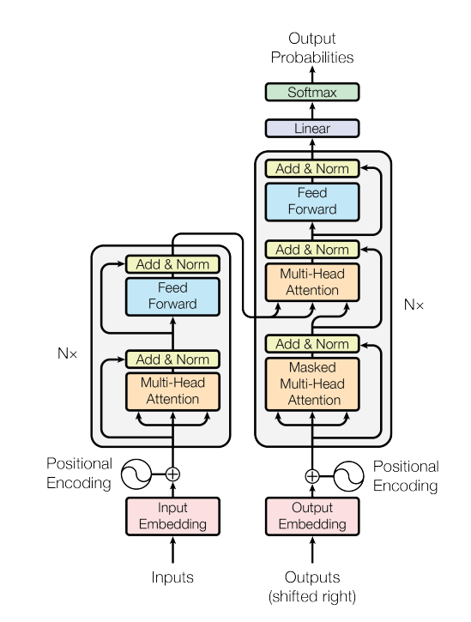
Model Architecture
encoder input sequence:
X = (x₁, ... , x_{n})
encoder output sequence:
Z = (z₁, ..., z_{n})
decoder output sequence:
Y = (y₁, ..., y_{m})
Transformer

Slide 12
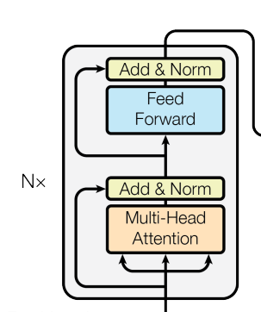
Model Architecture
The encoder is composed of a stack of N = 6 identical layers.
The first is a multi-head self-attention mechanism.
The second is a fully connected feed-forward network.
Encoder

Slide 13
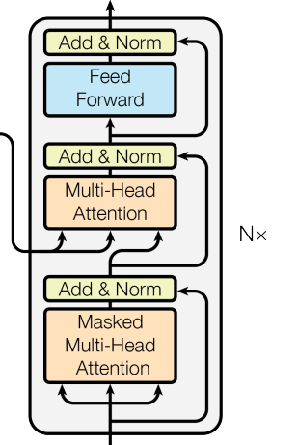
Model Architecture
The decoder is also composed of a stack of N = 6 identical layers.
Third sub-layer, which performs multi-head attention over the output of the encoder stack.
Decoder

Slide 14
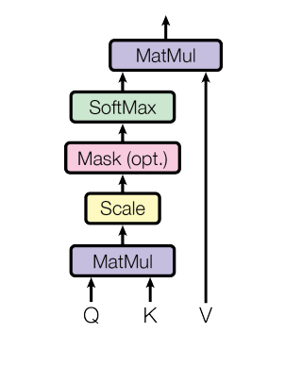
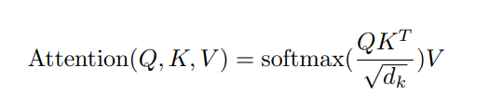
Model Architecture
The input consists of queries and keys of dimension dk, and values of dimension dv.
The two most commonly used attention functions are additive attention , and dot-product attention.
Scaled Dot-Product Attention

Slide 15
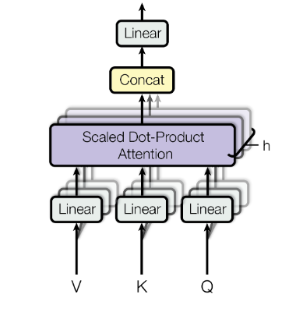
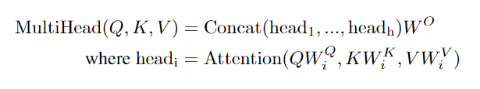



Model Architecture
Multi-head attention allows the model to jointly attend to information from different representation subspaces at different positions.
8
Multi-Head Attention

Slide 16
Model Architecture
Transformer uses multi-head attention in three different ways:
In "encoder-decoder attention" layers, the queries come from the previous decoder layer, and the memory keys and values come from the output of the encoder.
The encoder contains self-attention layers.
Self-attention layers in the decoder allow each position in the decoder to attend to all positions in the decoder up to and including that position.

Slide 17
Model Architecture
1.
2.
3.

Slide 18

Model Architecture
Each of the layers in our encoder and decoder contains a fully connected feed-forward network.
Consists of two linear transformations with a ReLU activation in between.

Slide 19
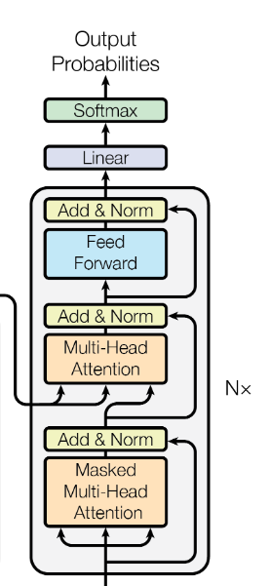
Model Architecture
Learned linear transformation and softmax function to convert the decoder output to predicted next-token probabilities.
Share the same weight matrix between the two embedding layers and the pre-softmax linear transformation.

Slide 20
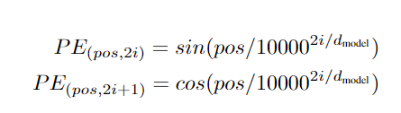
Model Architecture
In order for the model to make use of the order of the sequence, we add positional encodings.
sine and cosine functions of different frequencies:
Each dimension of the positional encoding corresponds to a sinusoid.

Slide 21
Model Architecture
Allow the model to easily learn to attend by relative positions.
Allow the model to extrapolate to sequence lengths longer than the ones encountered during training.

Slide 22
Why Self-Attention

Slide 23
Why Self-Attention
Three desiderata:
total computational complexity per layer.
the amount of computation that can be parallelized.
the path length between long-range dependencies in the network.

Slide 24
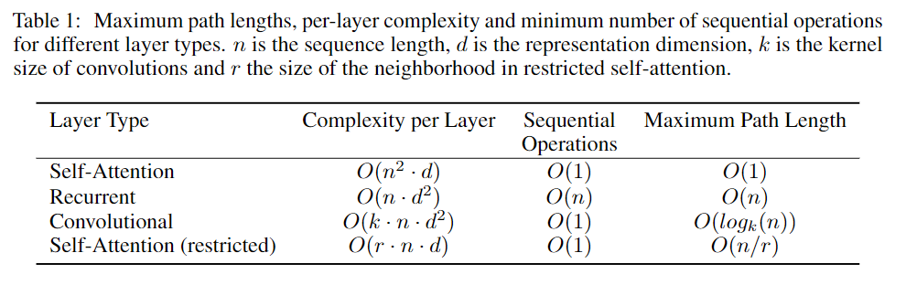
Why Self-Attention
Sequential Operations
Self-Attention V.S. RNN
Complexity
When n < d,
Self-Attention faster than RNN.
Such as word-piece and byte-pair.

Slide 25
Why Self-Attention
Self-Attention(restricted)
restricted to neighborhood of size r
Convolutional
Kernel width k < n,
doesn’t connect all pairs of input and output positions.

Slide 26
Why Self-Attention
Convolutional
To increase the length:
Contiguous kernels: stack of O(n/k)
Dilated convolutions: stack of O(log_{k}(n))
Convolution V.S. Recurrence
Separable convolutions:
Decrease complexity to O(k·n·d+n·d²)

Slide 27
Training

Slide 28
Training
Training Data and Batching:
For English-German, train on the standard WMT 2014 English-German dataset consisting of about 4.5 million sentence pairs, sentences were encoded using byte-pair encoding.
For English-French, used the significantly larger WMT 2014 English-French dataset consisting of 36M sentences and split tokens into a 32000 word-piece vocabulary.
Each training batch contained a set of sentence pairs containing approximately 25000 source tokens and 25000 target tokens.

Slide 29
Training
Hardware and Schedule :
trained with 8 NVIDIA P100 GPUs
For base models, each training step took about 0.4 seconds. Trained the base models for a total of 100,000 steps or 12 hours.
For big models, step time was 1.0 seconds. The big models were trained for 300,000 steps (3.5 days).

Slide 30

Training
Optimizer :
Adam optimizer with β₁ = 0.9, β₂ = 0.98 and ɛ = 10⁻⁹.
Learning rate formula ( warmup_steps = 4000 ):

Slide 31
Training
Regularization
Residual Dropout :
apply dropout to the output of each sub-layer, before Add & Norm.
apply dropout to the sums of the embeddings and the positional encodings .
P_{drop} = 0.1
Label Smoothing:
label smoothing of value ɛ_{ls} = 0.1
model learns to be more unsure, but improves accuracy and BLEU score.

Slide 32
Results

Slide 33
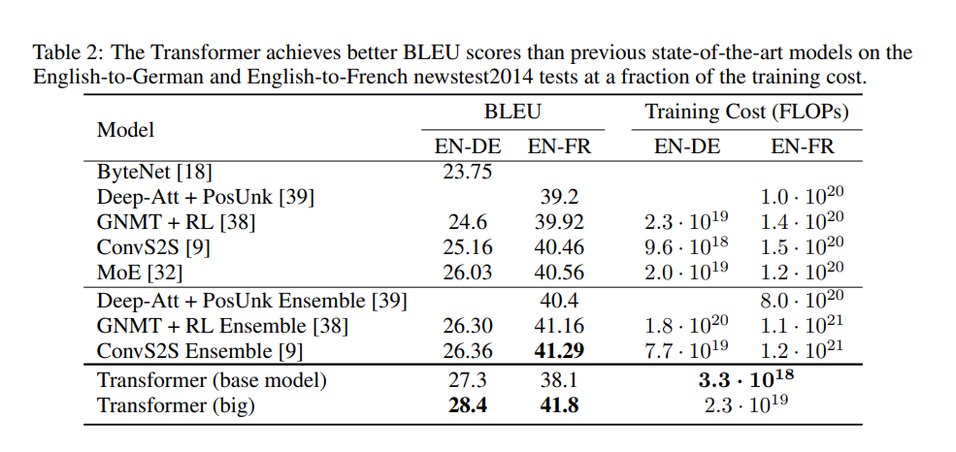
Result

Slide 34
Result
For the base models, used a single model obtained by averaging the last 5 checkpoints, written at 10-minute intervals.
For the big models, averaged the last 20 checkpoints.
Beam search with a beam size of 4 and length penalty α = 0.6.

Slide 35
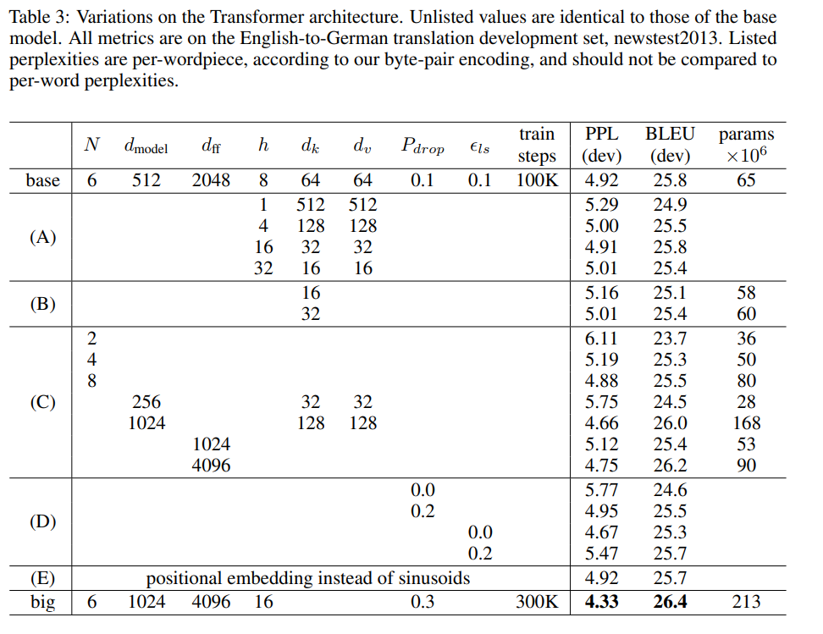
Result

Slide 36
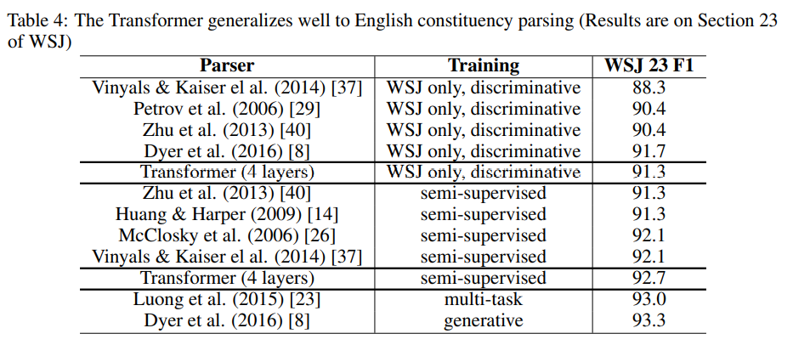
Result

Slide 37
Result
Performed only a small number of experiments to select the dropout, both attention and residual.
Other parameters remained unchanged from the English-to-German base translation model.
The maximum output length to input length + 300.
Beam size of 21 and α = 0.3 for both setting.

Slide 38
Conclusion

Slide 39
Conclusion
The first sequence transduction model based entirely on attention.
For translation tasks, the Transformer can be trained significantly faster than architectures based on recurrent or convolutional layers.
Plan to extend the Transformer to problems involving input and output modalities other than text and to investigate local, restricted attention mechanisms to efficiently handle large inputs and outputs.

Slide 40
Appendix

Slide 41
Appendix
As side benefit, self-attention could yield more interpretable models.
Not only do individual attention heads clearly learn to perform different tasks, many appear to exhibit behavior related to the syntactic and semantic structure of the sentences.

Slide 42
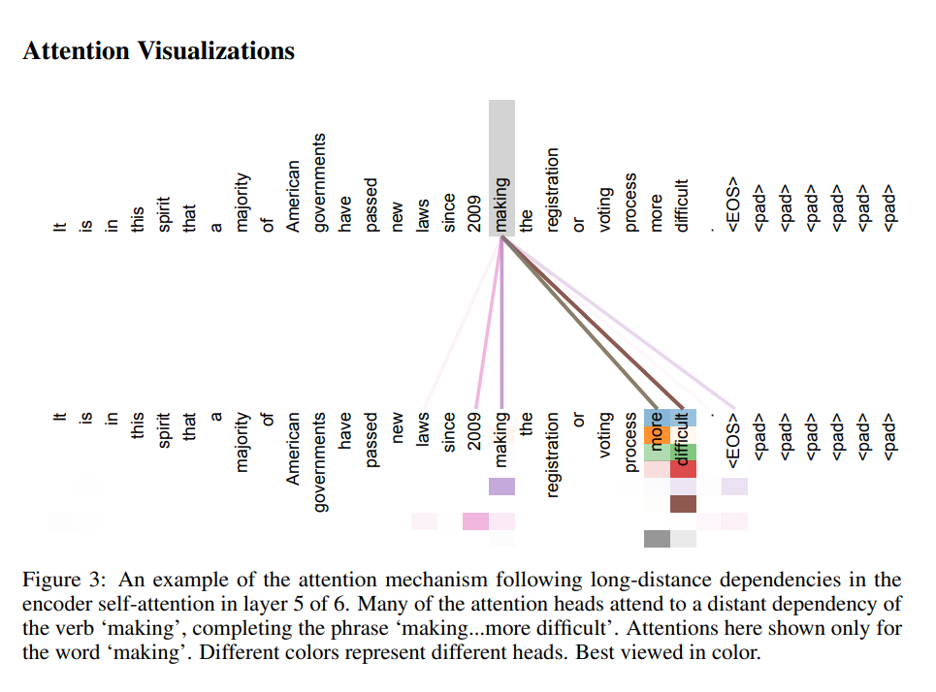
Appendix

Slide 43
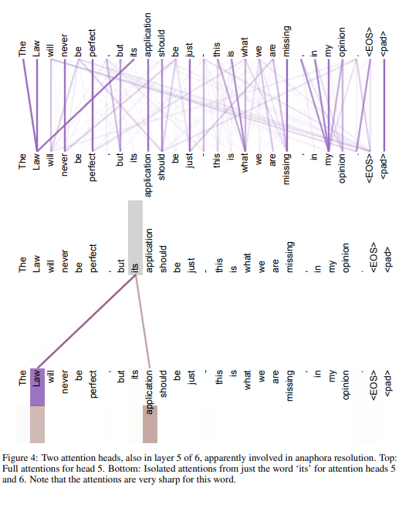
Appendix

Slide 44
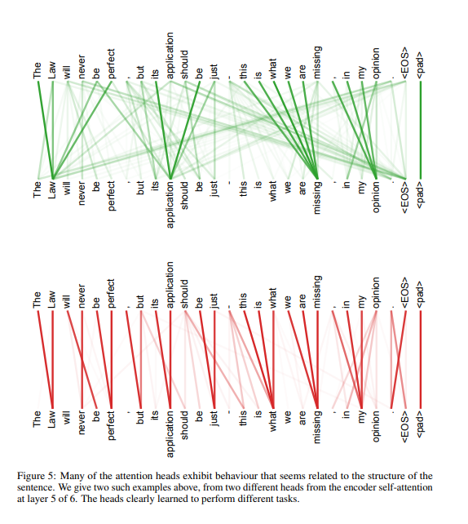
Appendix

Slide 45
Thank You For Listening

